Slide 1
Sunnikan Consulting
Quality, Process and Risk Management Systems
Consulting and Services for Pharmaceuticals and Medical Devices Industry
"SUNNIKAN": from Greek "Syn", which means "together," and "Nikhein", which means "to win"
Notes:
1

Slide 2
Sunnikan's Assignment
Design, implement, maintain, and use the Quality, Process and Risk Management Systems aimed at guaranteeing:
  patients' security and respect of their rights
  regulatory compliance
  collect of reliable data

Slide 3
Introduction
Sunnikan Consulting is an Independent company launched in 1996 and managed by Georges MARTIN, M.D.
Sunnikan is leader on the French clinical quality management market (clinical research, epidemiology, pharmacovigilance)
Sunnikan is always looking for excellence and "win-win" solutions through :
  meeting customers' expectations
  extensive continuous training of the Consultants
  sharing internal knowledge databases
  innovating in the working methodologies

Slide 4
Organisation interne
Direction
Gérant / CEO
Assistante Direction
Juristes *
Direction des Opérations
3 Directrices des Opérations / Operations Managers
Gestionnaire de Missions **
Mission
1 Consultant Senior + Consultants
(Seniors, Expérimentés, Juniors)
Pré-devis
Devis Contrat Planification
Attribution ressources
OK
Participation pré-devis, devis
Livrables client
Indicateurs Sunnikan
Écoute clients / remontée des besoins
Facturation et suivi
Bilan de fin de mission
Revue de mission / actions d'amélioration
Gestionnaire Systèmes & Réseaux ***
* Veille, capitalisation, assistance réglementaire interne et externe, contrats clients, juridique Sunnikan
** Support aux Opérations, aux Consultants, facturation
*** Systèmes d'Information

Slide 5
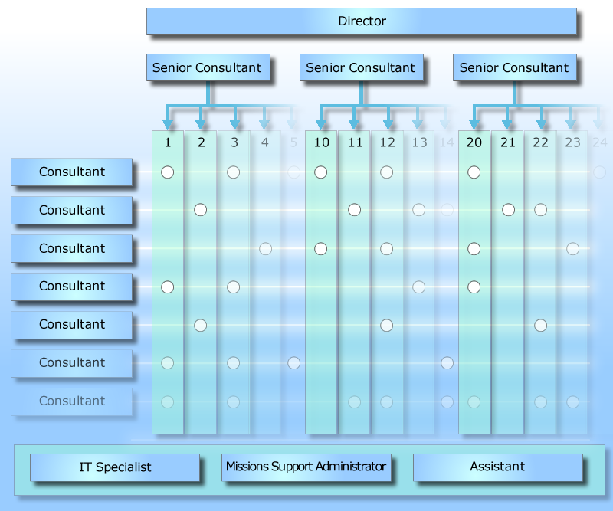
Organization
12 Consultant(e)s
  4 Pharm. D.
  2 Legal Experts
  1 MD Engineer
  5 Scientists
Other positions
  1 Support Administrator
  1 IT Specialist
  1 Assistant
Locations (France)
  Fontenay-sous-Bois (near Paris)
  Lyon
  Bordeaux
Notes:
There are 11 of us
SUNNIKAN Consulting
5

Slide 6
Fields of expertise
Safety
Pharmacovigilance
Cosmetovigilance
Medical Device vigilance
Clinical Research & Development
Observational Studies
Computerized System Validation
Regulatory Affairs
Market Access
Preclinical Studies
IMP Manufacturing

Slide 7
Fields of expertise
Components and products of the human body
Medical Gases
Non Health Products
Medical Devices
Allergens
Drugs
Cosmetics
Blood derived Drugs
Gene
Therapy
Vaccines

Slide 8
Fields of expertise
Pharmaceutical Industry
Health Public Institutions (hospitals, research centres)
Biotech companies
Service providers (Clinical Research Organisations, Central Labs, IT companies…)
Medical device manufacturers
Cosmetic products
manufacturers

Slide 9
Consulting and Services
Regulatory Intelligence
  Sunnikan Regulatory Intelligence Bulletin « Research involving human sujects»
  Sunnikan Regulatory Intelligence Bulletin "Genetically modified organisms
  Distribution of "Safety Observer" (PV FOCUS)
  Regulatory assistance
Quality, Process and Risk Management
  Setup and maintenance of Quality Management Systems (Quality, Process, Risk)
  Procedure writing (Quality Assurance, Standard Operating Procedures, Risk Management…)
  Audits (organizational, regulatory (Good Practices, ISO...), sites, subcontractors, Trial Master Files...)
  Quality Control
  Quality approaches (ISO 9001…)
  Training
Computerized Systems Validation
Notes:
SUNNIKAN Consulting
9

Slide 10
Consulting
Modalities
  Proposal describing the methodology of the mission
Cost
  Rate : 1.200 Euros net of tax / Consultant / Day
Notes:
SUNNIKAN Consulting
10

Slide 11
Writing / Updating procedures
Set of procedures
  Quality Management
  Clinical Research
    Process of conducting a clinical trial
    Data Management
    Statistics
  Data protection
  Pharmacovigilance
  Regulatory Affairs
  Medical Information
  Training of Medical Sales Representatives
  Market Access
  Epidemiology

Slide 12
Writing /Updating procedures
Defining the requirements (≈ Project specifcations)
  field of application
  concerned procedures / processes
  pre-existing documents
  format, language…
  forms
Definition of the modalities of the execution of the mission
Notes:
SUNNIKAN Consulting
12

Slide 13
Writing /Updating procedures
"Work groups" solution
  supply of a working document (an annotated client's document or a "generic" SUNNIKAN document)
  2 to 4 persons work groups, per subject, with 1, 2 or x meetings depending on the process definition level
  delivery of intermediate versions (v0.1, v0.2, etc.)
  whether SUNNIKAN is involved or not in the integration of the compiled comments
Advantages : participation, appropriation
Difficulties : "Client's" availability, heavy logistics, long-range mission
Notes:
SUNNIKAN Consulting
13

Slide 14
Writing /Updating procedures
"Interview" solution
  same methodology as the "Work goups" solution, the work groups will be replaced by interviews with a process expert
Advantages : a less heavy logistic
Difficulties : recognition value of the process expert from his peers
Notes:
SUNNIKAN Consulting
14

Slide 15
Writing /Updating procedures
" Regulatory Review" solution
  applicable for the existing and updated documents concerning processes
  purely a regulatory review
  whether Sunnikan is involved or not in the integration of the compiled comments
Advantages : regulatory updated documents, time-saving for the Client
Difficulties : non reviewed document for the other sides (terminology, validity of the process, consistency with the other documents, etc.)
Notes:
SUNNIKAN Consulting
15

Slide 16
Writing / Updating procedures
Success factors of a "Writing / Updating procedures" mission
  only one Project Manager : to make decisions, compile comments
  A Mission Support Administrator : for back-up, logistics
  client preparation time
  terminology fixed from the beginning (titles, positions, documents…)
Sunnikan Consulting's assets
  standardized working methodology based on knowledge shared between Consultants
  coordination by a Senior Consultant
  homogeneity of deliverables
  pluridisciplinary staff

Slide 17
Quality Control
Types of controls
  Clinical Documentation
    Clinical study report
    Application Dossier (Clinical Summary, Clinical Overview)
    Clinical Study Authorization Dossier
    Case Report Forms
  PSUR
Methodology
  definition of the field of control (objectives, critical data, chapters…)
  100% control of the verifiable compared to the reference data (appendix, line-listing…)
  Simplified report
    classification of observations
    references
    assessment
Notes:
SUNNIKAN Consulting
17

Slide 18
Auditing
Organizational Audits
System Audits / Process Audits
  Project management, monitoring, medical writing, regulatory process
  data management, statistical analysis
  vigilance, management of investigational medicinal products, archiving
  Central labs, bioanalysis labs, bioanalysis methods
  Computerized Systems Validation
  Risk management …
Contract Research Organizations and other providers
  qualification audits
  follow-up audits
Clinical Study Audits
  documentation (Trial Master File)
  Investigation sites
  Clinical Databases
  Clinical Study Reports…

Slide 19
Audits
Mission Methodology
  List of requirements
    objective and scope
    processes and procedures covered
    Audit Report format…
  Definition of the modalities of the execution of the mission
    interviews, meeting for restitution of the audit results,
    if site audit, a prior audit of the study documentation…
  Drafting of a proposal, specifying the modalities of the execution
  Execution
    feedback no later than 24 hours working , in case of major observation
    sending of the draft of the audit report project for review
    Final audit report, audit certificate
Notes:
SUNNIKAN Consulting
19

Slide 20
Auditing: Areas
Clinical Research and Development
  interventional clinical trials
  observational clinical studies
Pharmacovigilance
Marketing Authorization Holders
Regulatory Affairs, Market Access
Computerized Systems Validation
Notes:
SUNNIKAN Consulting
20

Slide 21
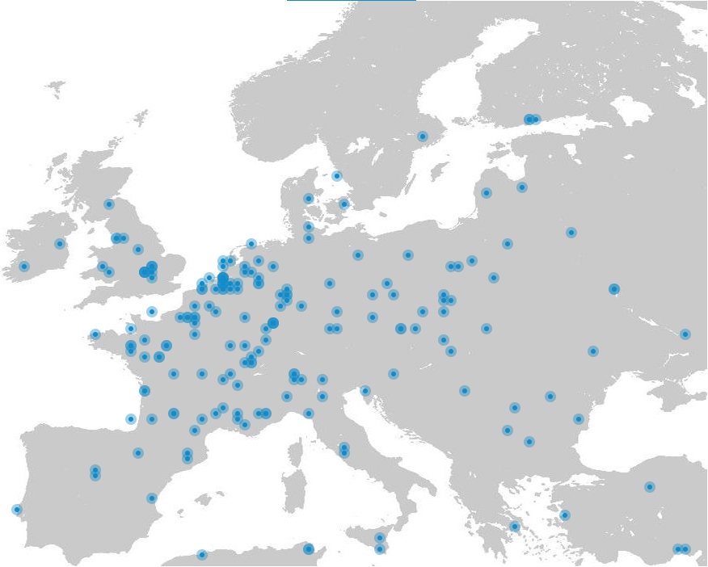
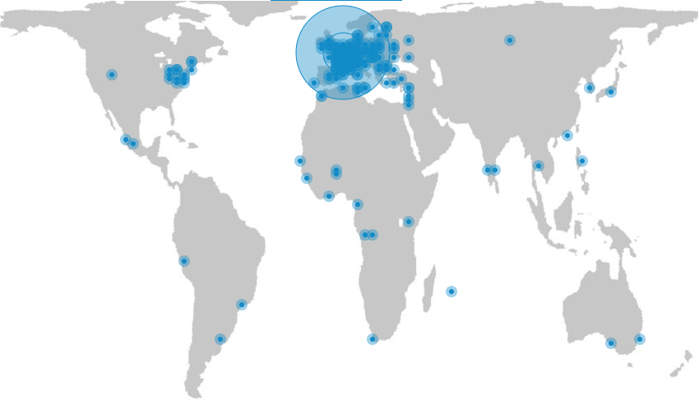
Auditing
Notes:
SUNNIKAN Consulting
21

Slide 22
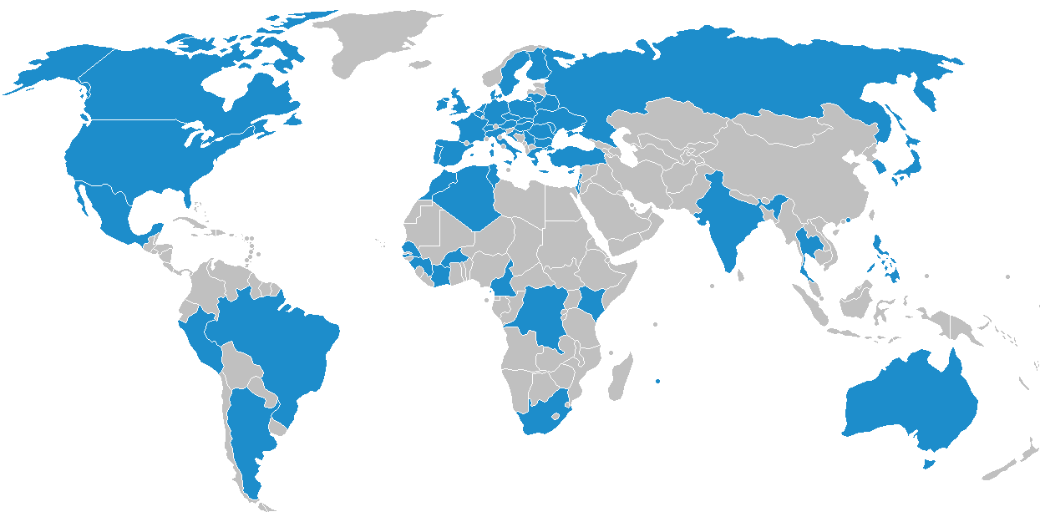
Auditing
Notes:
SUNNIKAN Consulting
22

Slide 23
Some examples of international clinical audit assignments
Preclinical study site audits, 2015, France and Canada (medicinal product)
Site audits, 2015, France and Burkina Faso (vaccine)
Trial master file audit, 2015, Switzerland (medicinal product)
Site Audits, 2015, Democratic Republic of Congo (medicinal product)
CROs and investigational sites audits, 2013-2014, Mexico, Argentina, France, UK, Spain, Germany (medicinal product / medical device)
Phase I investigational site audit, 2012, South Africa (medicinal product)
5 investigational site audits, 2012, Turkey (upon request of the Turkish Ministry of Health)
Investigational site audits, 2012, Bulgaria and Spain (medicinal product)
Central imaging core lab, 2012, Latvia (medical device)
Data management process audit, 2011, Finland
In 2014, Sunnikan performed 75 audits

Slide 24
Audits performed in 2014 and in 2015 (ongoing)
 | Study activities | Centre | Materio Vigilance | PV Corporate | PV Distributor | PV Subsidiary | PV Provider | Provider Qualification | Systems | TMF | Total
2014 | 13 | 26 |  | 2 | 1 | 5 | 3 | 9 | 10 | 6 | 75
2015 | 12 | 7 |  |  | 2 | 1 |  | 4 | 6 | 7 | 39

Slide 25
Audits
Objectives of the audits
  Respect of the audit Plan
  Preperation to headquarters audits / clients' audits
  Preperation to inspections
  "For Cause" Audit
Notes:
SUNNIKAN Consulting
25

Slide 26
Audits
Control of the main audit references
  French regulation in clinical trial and non interventional study (French Public Health Code, Good Clinical Practices, "Protection of personal data", etc.)
  French regulation relating to "Exploitant" Pharmaceutical Sites (French Public Health Code)
  European regulation relating to clinical trials (directive 2001/20/EC and its detailed guidances, annex 13 of Good Manufacturing Practices, etc.)
  Guidelines ICH (E6, E3, E9, etc.)
  Good Clinical Data Management Practices
Notes:
SUNNIKAN Consulting
Version du 21 janvier 2010
Sunnikan_Presentation / Copyright© SUNNIKAN Consulting 2010 - Tous droits réservés
26
SUNNIKAN Consulting
26

Slide 27
Audits
Mission Methodology
  Définition of the requirements (≈list of specifications)
    objective and field of application
    concerned procedures / processes
    Format, language of the report…
    Suggestions of improvements
    meeting for restitution of the audit results
  Definition of the modalities of the execution of the mission
    interviews, meeting for restitution
    if site audit, a prior audit of the study documentation…
  Execution
    feedback no later than 24 hours working , in case of major observation
    sending of the draft of the audit report project for review
    Final audit report, audit certificate
Notes:
SUNNIKAN Consulting
27

Slide 28
Sunnikan Consulting's assets for auditing
Sunnikan's independence from Sponsors and Contract Research Organizations
Sunnikan Auditors' expertise in various areas
Sunnikan's capacity to conduct multiple audits with several Auditors:
  according to a common methodology
  under coordination of a Senior Auditor
A detailed Audit Agenda
A detailed Audit Report
An Executive Summary, summarizing the closure meeting
As requested, a suggested Action Plan
Notes:
SUNNIKAN Consulting
28

Slide 29
Intranet Sites of procedures
Définition of the requirements
Selection of a technical solution
Notes:
SUNNIKAN Consulting
29

Slide 30
Regulatory Intelligence Bulletin
"Research involving human subjects"
Regulatory Intelligence bulletin in research involving human subjects
Content
  Regulatory references (France, Europe, World-wide)
  recommandations et Good Practices
  References indirectly linked (ex : Conseil National de l'Ordre des Médecins, CNIL…)
  Impact analysis on the Quality Assurance System
Modalities
  12 bulletins per year (sent at the beginning of each month)
  1.500 euros net of tax fixed fees/ year, for one e-mail
  500 euros net of tax fixed fees per additional e-mail
  Circulation is permitted in the Service Subscriber
Notes:
SUNNIKAN Consulting
30

Slide 31
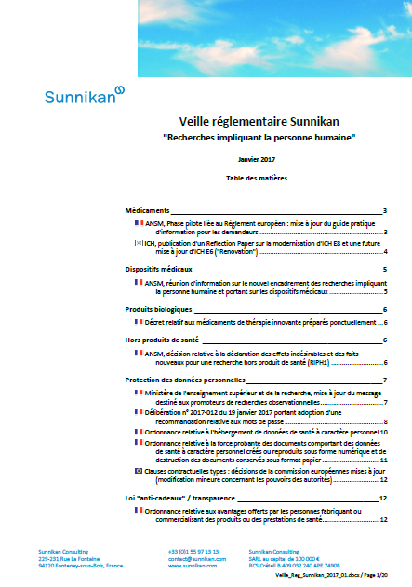
Regulatory Intelligence Bulletin
"Research involving human subjects"
Regulatory Intelligence bulletin in research involving human subjects
Content
  Regulatory references (France, Europe, World-wide)
  recommendations et Good Practices
  References indirectly linked (ex : Conseil National de l'Ordre des Médecins, protection of individual data…)
  Impact analysis on the Quality Assurance System
12 issues per year sent at the beginning of each month
Notes:
SUNNIKAN Consulting
31

Slide 32
Regulatory Intelligence Bulletin
"Genetically modified organisms"
Regulatory Intelligence bulletin in genetically modified organisms
Content
  Fundamental, preclinical and clinical researches on GMOs
  Regulatory references (France, Europe, World-wide)
  recommendations and Good Practices
  References indirectly linked (ex : contained use, deliberate release …)
12 issues per year sent at the beginning of each month
Notes:
SUNNIKAN Consulting
32

Slide 33


Distribution of the Regulatory Intelligence Bulletin
"Safety Observer"
International Regulatory Intelligence Bulletin in pharmacovigilance
Developed by - Thierry HAMARD
Content
  Complete review of the International, American, European requirements in terms of Pharmacovigilance
  Product alerts
A monthly Bulletin sent by e-mail, 11 Bulletins per year
To date, over 400 users worldwide
Notes:
SUNNIKAN Consulting
33

Slide 34
Regulatory Assistance
Scope
  Regulatory references related to biomedical research, non interventional studies
  References indirectly linked to clinical research and development (CNIL, Conseil National de l'Ordre des Médecins…)
  Drugs, Medical devices non health products…
Modalities
  Purchase in davance of a regulatory assistance day (=8 hours, available 2 years)
  Request by an authorized person of the Client
  Written answer within 48 hours working, by email
  A summary of the accounting of the time spent on each assistance
Notes:
SUNNIKAN Consulting
34

Slide 35
Regulatory Assistance
Scope
  regulatory references related to biomedical research, observational studies
  references indirectly linked to clinical research and development (individual data protection, National Medical Council…)
  drugs, medical devices, non health products…
Modalities
  Purchase in advance of a regulatory assistance day (= 8 hours, available 2 years)
  Request by an authorized person of the Client
  Written answer within 48 hours working, by email
  A summary of the accounting of the time spent on each assistance
Notes:
SUNNIKAN Consulting
35

Slide 36




Risk Management
Design and setup of Risk Management Systems
Risk Analysis
Crisis Plans
Business Continuity Plans
…
Crisis Management Procedures
Risk Management system
Risk Management Procedures
Risk Analysis
Business Continuity Plan
Crisis Plan
Notes:
SUNNIKAN Consulting
36

Slide 37
Computerized Systems Validation
Services
  Consulting
  Procedures writing
  Validation operations
  Audits
  Training
References
  Regulations (e.g.: 21 CFR Part 11, GxP…)
  GAMP 5
  PIC/s
Notes:
SUNNIKAN Consulting
Version du 17 février 2010
Sunnikan_Presentation / Copyright© SUNNIKAN Consulting 2010 - Tous droits réservés
37
SUNNIKAN Consulting
37

Slide 38
Public Training Courses
"Two days to learn how to be conversant in the audit know-how"
(2 days)
"Preparation to Clinical Research Inspections"
(1 day)
"Computerized System Validation (CSV) applied to Clinical Research and Pharmacovigilance"
(2 days)
"Quality, Process, and Risk Management in Clinical Research"
(2 days)
  Modalities
  Location : Sunnikan Consulting facility (Paris)
Notes:
SUNNIKAN Consulting
38

Slide 39
Dedicated Training Courses
Regulations in Clinical Trials
  "Clinical Trials: ICH GCP"
  "Clinical Trials: European Regulations"
  "Clinical Trials: French Regulations"
  "Regulatory steps in Clinical trials (Ethics Committee, Competent Authority, CNIL, CNOM)"
  "Epidemiological Study Regulations"
Pharmacovigilance
  "Pharmacovigilance of PASS studies, epidemiological studies"
  "Spontaneous notification in Pharmacovigilance"
Quality / Audits
  "Subcontractor Audits : qualification & follow-up"
  "Epidemiological Study Audits"
  "System Audits"
Computerized Systems Validation
  "Introduction to Computerized Systems Validation "
  Modalities
  Standard or customized training sessions
  Location : Sunnikan Consulting facilities or Client's facilities

Slide 40
Training for Investigators
Plenary session training
  "Investigators : their responsibilities towards the French regulation"
  "Investigators : Good Clinical Practices ICH"
  "Investigators : French Good Clinical Practices"
"e-learning"
  To the French regulation for the Investigators
  1-hour training to get to know the French regulation related to biomedical research
  Presentation + audio comments + Quizz
  Certificate, if the answers to the Quizz are satisfactory
Notes:
SUNNIKAN Consulting
40

Slide 41
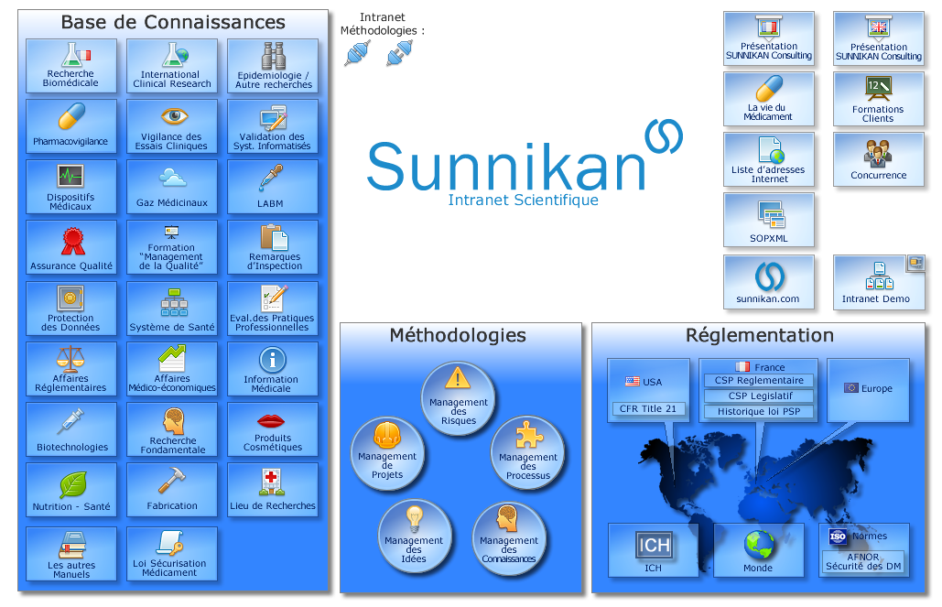
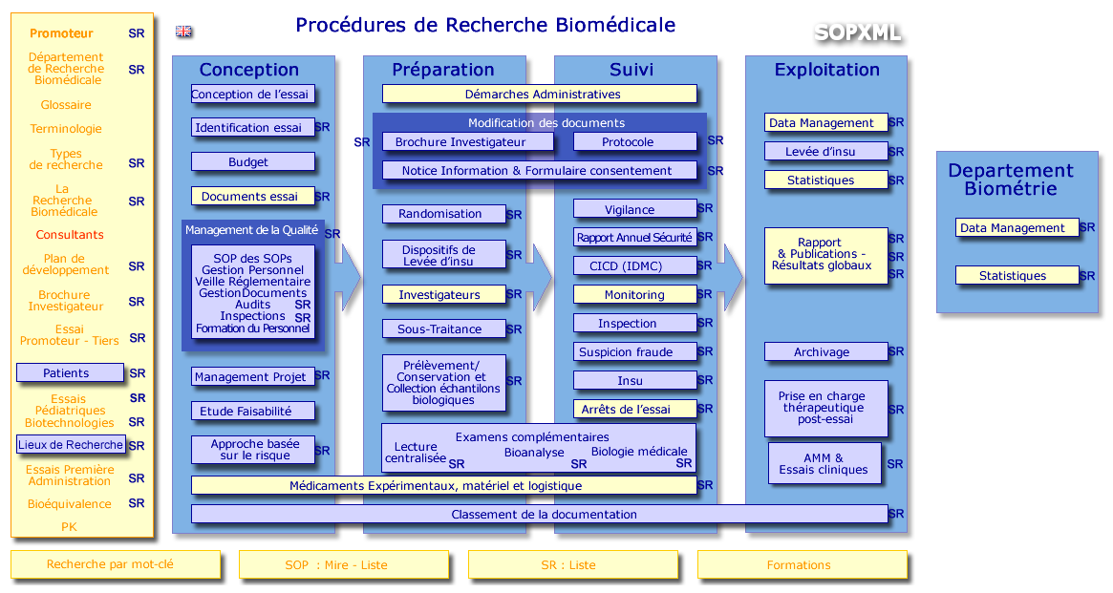
Sunnikan Consulting's working methodology
Standardized working methodology based on knowledge sharing between Consultants
  knowledge databases
  regulations, thematic overviews, templates, forms…
Notes:
SUNNIKAN Consulting
41

Slide 42
List of Sunnikan Consulting's methodologies
Updated
Audit methodology 17/06/2013
Protocol Quality Control methodology 06/02/2013
Report Quality Control methodology 28/05/2013
SOP writing methodology 25/06/2013
Inter and intra-companies training course conduct methodology 05/03/2013
Regulatory assistance methodology 13/03/2013
Project management methodology 07/06/2013
Methodology for capitalizing the scientific intranet 13/03/2013
Methodology – SUN.eVeille Recherche Biomédicale 25/06/2013
Methodology – Safety Observer 25/06/2013

Slide 43



































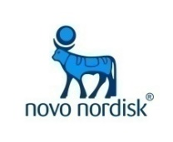









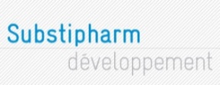









Main references
Pharmaceutical Companies
PROSKELIA
Notes:
SUNNIKAN Consulting
43

Slide 44
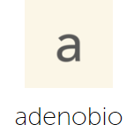










Main references
Biotechnology companies

Slide 45

































Main references
Service Providers
Notes:
SUNNIKAN Consulting
45

Slide 46


















Main references
Institutions and Research Organizations
Notes:
SUNNIKAN Consulting
46

Slide 47



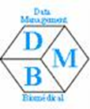





Associations and Academic Societies

Slide 48
The Consultants
Notes:
SUNNIKAN Consulting
48

Slide 49
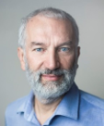
Georges MARTIN
Engineer, M.D., Senior Consultant, Director
Oct. 1996 Creation of SUNNIKAN Consulting
1995-1996 BAYER, European Medical Affairs
  Head of European Quality Management
1992-1995 BAYER PHARMA France
  Head of Methods & Quality Assurance
  First ISO 9001 certification in the world for clinical research
1989-1992 BRISTOL MYERS SQUIBB France
  Methods & Quality Assurance Director
1987-1989 INSTITUT HENRI BEAUFOUR
  Clinical Project Leader for Phases I-II
  Worldwide drug safety database for an antihypertensive drug
1984-1987 IPSEN
  Clinical Project Leader, TANAKAN Therapeutic Group Leader
1987 Doctor in Medicine - Créteil Medicine University
1985 Statistics degree from CESAM - Paris
1974 Engineering degree from Polytechnic Institute for Applied Sciences
(aeronautics, aerospace) - Paris
Notes:
SUNNIKAN Consulting
7 septembre 2008
Forma_MQ_02_Sunnikan
49

Slide 50
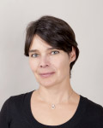
Frédérique ALBOUY-NAVARRO
Senior Consultant, Pharm.D.
1999 SUNNIKAN Consulting, Consultant
  Areas: Clinical Research, Pharmacovigilance,
  Regulatory Affairs
  Group facilitation process
  Operational Procedures / Quality Systems drafting
  Audits in Clinical Research, Pharmacovigilance
  Trainings in Quality Management
1994-1999 BAYER PHARMA France
(Trainee, Project leader, then Senior Project Leader in Methods and Quality Assurance for clinical R&D and drug safety)
  Clinical quality assurance
  Methods
  ISO 9001/9002 Certification
1995 DESS "Drug Quality Assurance" (Paris V University)
1995 Pharmacist degree

Slide 51
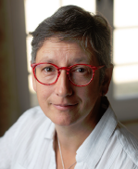
Catherine MÉRAT
Senior Consultant, Pharm.D.
2006 SUNNIKAN Consulting
  Areas: Clinical Research, Epidemiology
  Group facilitation process
  Operational Procedures / Quality Systems drafting
  Audits in Clinical Research, Pharmacovigilance
  Trainings in Quality Management
2002-2006 PRA International Manager of Clinical Operations
  Management of the French team of Clinical Research Associates
  Responsible for the application of procedures and regulations related to Clinical Operations (quality control)
1994-2001 ARCAM / PRA International
  Clinical trials management and feasibility studies
  Pharmacovigilance: management of Serious Adverse Events Reports and follow-up
  Quality Assurance: drafting and updating of SOPs, Quality control
  Training of CRAs, junior Project Leaders, Investigators
1992-1994 ARCAM, France, Clinical Research Associate
1990 Pharm.D., Besançon University, France
Notes:
SUNNIKAN Consulting
7 septembre 2008
Forma_MQ_02_Sunnikan
51

Slide 52
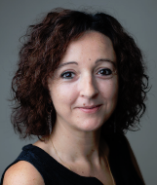
Cindy BERNAT ARLAUD
Senior Consultant
2008 SUNNIKAN Consulting
  Areas: Clinical Research, Epidemiology, Computerized Systems
  Validation (CSV)
  Operational Procedures / Quality Systems drafting
  Audits in Clinical Research, CSV
  Trainings (regulatory, audits, CSV)
2002-2008 ROCHE, France, Medical Direction – Clinical Operations
Project Officer, Clinical Research Associate
Coordination of eCRF Development and Validation (IQ, OQ, PQ)
Support in management of clinical Trials
2001-2002 LUNDBECK, France, International Department of Health Economy and Epidemiology, Associate Project Manager
Realization of pharmaco-economic positioning files (Alzheimer & Parkinson diseases)
Support in initiation of international observational studies
2006 MASTER II (Post-graduate specialization) in "Project and Business Management", CNAM, Paris
2001 MASTER II (Post-graduate specialization) in “Neurobiology and Neuropsychology of Human Behavior: applications to Health”, Paris
Notes:
SUNNIKAN Consulting
7 septembre 2008
Forma_MQ_02_Sunnikan
52

Slide 53
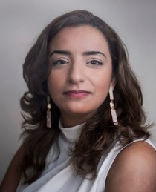
Lobna MIFTAH-ALKHAIR
Consultant
2011 SUNNIKAN Consulting
SOP writing : quality systems, clinical research, data management,
statistics
International clinical audits : investigation sites, clinical study reports, bioanalysis lab…
Quality controls: TMFs, study reports, databases
Regulatory assistance
2010 INSERM UMRS 939 Research Laboratory
Dyslipidemia, Inflammation and atherosclerosis in metabolic diseases
Hôpital La Pitié-Salpêtrière - Paris
2010 Master 2 "Assurance Qualité des Produits de Santé"
Faculté des Sciences Pharmaceutiques et Biologiques Paris Descartes
2009 Master 1 "Sciences du Médicament"
"Biologie dirigée vers la Pharmacologie et la Toxicologie"
Paris Descartes University (France)
2008 Licence "Sciences du Vivant et de la Santé"
Paris Descartes University (France)

Slide 54
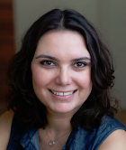
Raphaëlle KUHN
Consultante
  2012 Sunnikan Consulting, Consultante en Pharmacovigilance, vigilance des essais cliniques
  Rédaction de procédures (Opérationnelles, Système qualité)
  Rédaction de PSMF
  Animation de groupes de travail
  Formations (Nouvelle réglementation de pharmacovigilance)
  Audits (Système)
  Contrôles qualité (ICSRs, PSURs, documents de Recherche Clinique (protocole, rapport d'étude ))
  2012 Hospices Civils de Lyon, France – Interne en pharmacie
  2011 European Medicines Agency, United Kingdom – Interne en pharmacie
  2010 Sanofi Pasteur, France – Interne en pharmacie
  2009 CRPV de Saint-Etienne, France – Interne en pharmacie
  2013 "Validation des Systèmes Informatisés en Recherche Clinique et
  Pharmacovigilance - Approfondissement des connaissances", Sunnikan
  2012 "Management de la Qualité, des Processus et des Risques en Recherche Clinique", Sunnikan
  "Deux jours pour maîtriser les savoir-faire de l'audit", Sunnikan
  2012 Diplôme d'Etat de Docteur en Pharmacie, Lyon I
  2011 DIU de Pharmacovigilance et sécurité du médicament, Lyon I
  2010 CESAM (Méthodologies statistiques et Pratique des essais cliniques), Paris VI

Slide 55
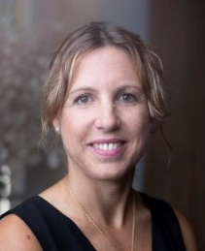
Leire OLAZABAL
Consultant
  2017 Sunnikan Consulting, Consultant in Clinical Research
  Audits
  System audits (quality, monitoring, project management, data management, statistical analysis)
  Clinical studies audits: Trial Master File, investigational sites, regulatory proceedings
  Contract research organization audits (qualification, follow-up)
  2007 Clinical Research and Innovation Department of the University Hospital of Bordeaux / South-West and Overseas Clinical Research and Innovation regional group, Quality Manager
  2007 Training on Clinical Research at the University of Bordeaux, the University Hospital of Bordeaux and the "Institut Supérieur Vidal Médical" of Bordeaux
  2002 CéMAX (phase I investigation center, Rouen), Quality Manager
  2017 "Regulatory requirements of health-related research involving Humans", Sunnikan
  2017 "Management of Quality, Processes and Risks in Clinical Research", Sunnikan
  2015 "ISO 9001:2015", AFNOR
  2012 " How to be conversant in audit know-how", Sunnikan
  2001 Master II "Quality Assurance", François Rabelais University, Tours
  2000 Master I "Toxicology", Paris V University
  1999 Bachelor's degree "Biochemistry", Paris VII University

Slide 56
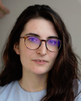
Pauline BENOIT-ISART
Legal Expert, Consultant
  2017 SUNNIKAN Consulting
  Clinical Research, Pharmacovigilance, Regulatory Affairs,
  Epidemiology
  Regulatory Intelligence & Assistance,
  Operational Procedures, Quality Systems drafting
  2018 Master 2 "Droit médical et de la santé" – Paris VIII
  2018 "Règlement général sur la protection des données", Sunnikan Consulting
  2017 "Guideline For Good Clinical Practice", Sunnikan Consulting
  2017 "Réglementation relative aux recherches impliquant la personne humaine (Loi "Jardé")", Sunnikan Consulting
  2017 Master 2 "Biotechnologies et Droit" – Tours, University François Rabelais
  2016 Master 1 "Biotechnologies et Droit" – Tours, University François Rabelais
  2015 Private Law Master's degree
Notes:
SUNNIKAN Consulting
7 septembre 2008
Forma_MQ_02_Sunnikan
56

